Slide 1

Analysis of Algorithms
Linear Sorting
(Chapter 8)

Slide 2

How Fast Can We Sort?

Slide 3
How Fast Can We Sort?
Insertion sort: O(n²)
Bubble Sort, Selection Sort:
Merge sort:
Quicksort:
What is common to all these algorithms?
  These algorithms sort by making comparisons between the input elements
Θ(n²)
Θ(nlgn)
Θ(nlgn) - average

Slide 4
Comparison Sorts
Comparison sorts use comparisons between elements to gain information about an input sequence ⟨a₁, a₂, …, a_{n}⟩
Perform tests:
a_{i} < a_{j}, a_{i} ≤ a_{j}, a_{i} = a_{j}, a_{i} ≥ a_{j}, or a_{i} > a_{j}
to determine the relative order of a_{i} and a_{j}
For simplicity, assume that all the elements are distinct

Slide 5
Lower-Bound for Sorting
Theorem: To sort n elements, comparison sorts must make Ω(nlgn) comparisons in the worst case.

Slide 6
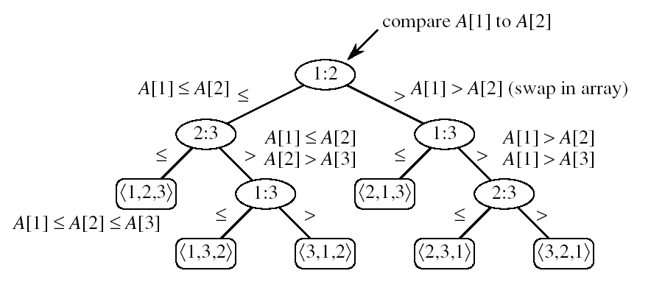
Decision Tree Model
Represents the comparisons made by a sorting algorithm on an input of a given size.
  Models all possible execution traces
  Control, data movement, other operations are ignored
  Count only the comparisons
node
leaf:

Slide 7
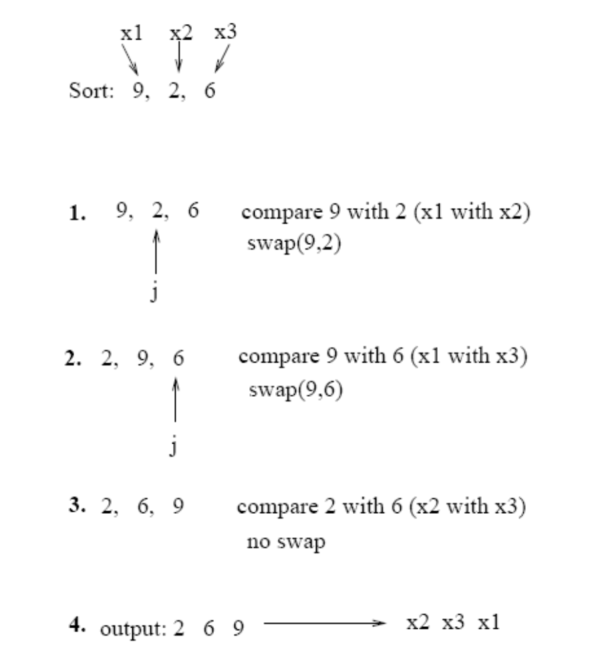
Example: Insertion Sort

Slide 8
Worst-case number of comparisons?
Worst-case number of comparisons depends on:
  the length of the longest path from the root to a leaf
  (i.e., the height of the decision tree)

Slide 9
Lemma
Any binary tree of height h has at most
Proof: induction on h
Basis: h = 0 ⇒ tree has one node, which is a leaf
2⁰ = 1
Inductive step: assume true for h-1
  Extend the height of the tree with one more level
  Each leaf becomes parent to two new leaves
  No. of leaves at level h = 2 ∗ (no. of leaves at level h-1)
  = 2 ∗ 2^{h-1}
  = 2^{h}
2^{h} leaves
4
1
3
h-1
2
16
9
10
h

Slide 10
What is the least number of leaves in a
Decision Tree Model?
All permutations on n elements must appear as one of the leaves in the decision tree:
At least n! leaves
n! permutations

Slide 11
Lower Bound for Comparison Sorts
Theorem: Any comparison sort algorithm requires Ω(nlgn) comparisons in the worst case.
Proof: How many leaves does the tree have?
  At least n! (each of the n! permutations if the input appears as some leaf) ⇒ n!
  At most 2^{h} leaves
⇒ n! ≤ 2^{h}
⇒ h ≥ lg(n!) = Ω(nlgn)
h
leaves
We can beat the Ω(nlgn) running time if we use other operations than
comparing elements with each other!

Slide 12
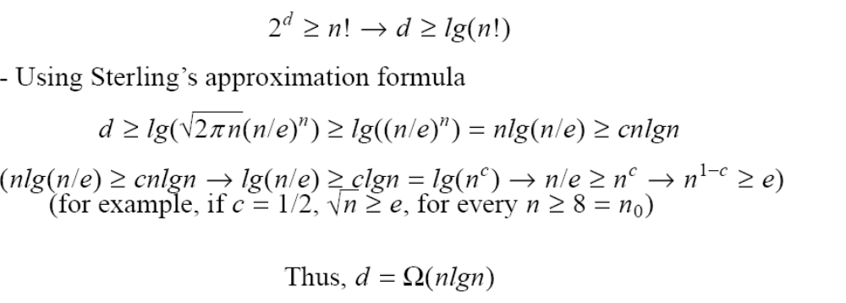
Proof
(note: d is the same as h)

Slide 13

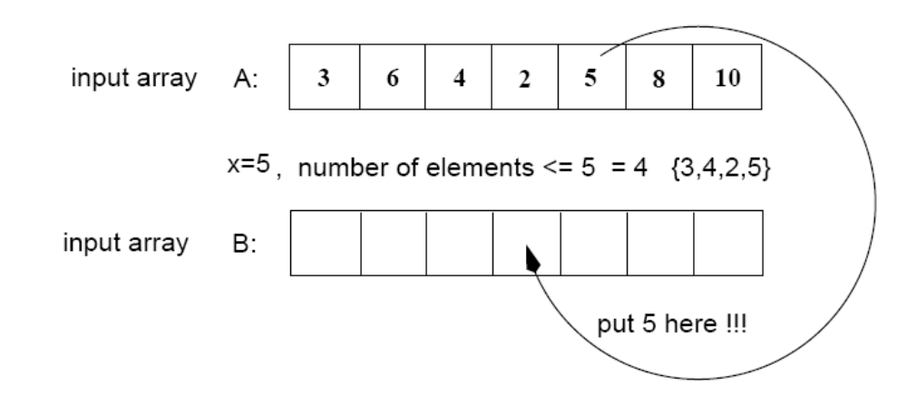
Counting Sort
Assumptions:
  Sort n integers which are in the range [0 ... r]
  r is in the order of n, that is, r=O(n)
Idea:
  For each element x, find the number of elements x
  Place x into its correct position in the output array
output array

Slide 14
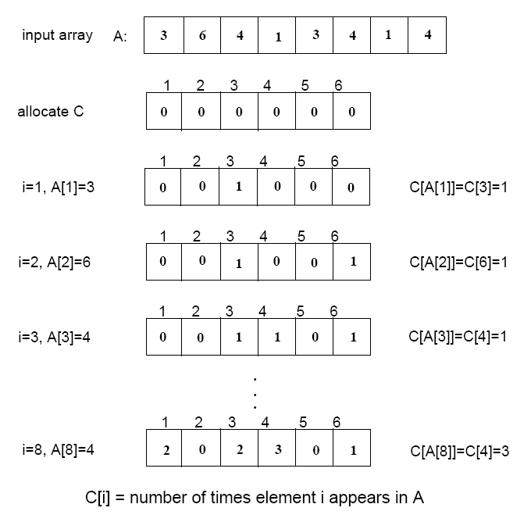
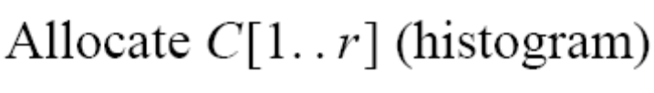

Step 1
(i.e., frequencies)

Slide 15
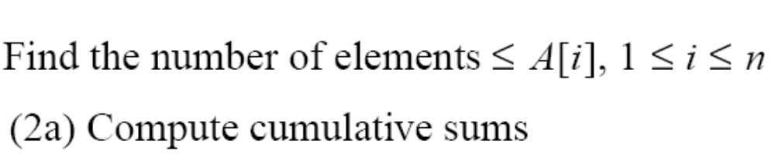
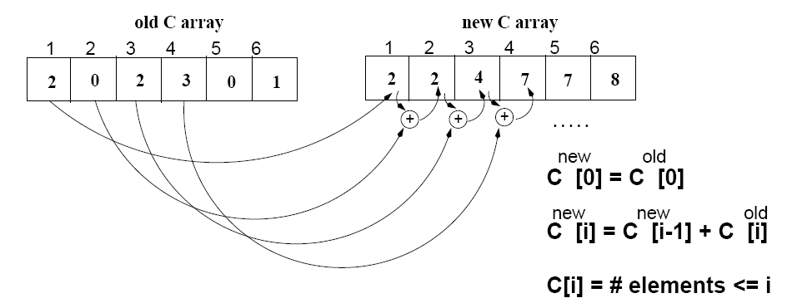
Step 2
(i.e., cumulative sums)

Slide 16
Algorithm
Start from the last element of A (i.e., see hw)
Place A[i] at its correct place in the output array
Decrease C[A[i]] by one

Slide 17
Example
1
2
3
4
5
6
7
8
0
1
2
3
4
5
A
2
5
3
0
2
3
0
3
C
2
2
4
7
7
8
0
1
2
3
4
5
(cumulative sums)
C
2
0
2
3
0
1
(frequencies)
1
2
3
4
5
6
7
8
1
2
3
4
5
6
7
8
B
3
B
0
3
0
1
2
3
4
5
0
1
2
3
4
5
C
2
2
4
6
7
8
C
1
2
4
6
7
8
1
2
3
4
5
6
7
8
1
2
3
4
5
6
7
8
B
0
3
3
B
0
2
3
3
0
1
2
3
4
5
0
1
2
3
4
5
C
1
2
4
5
7
8
C
1
2
3
5
7
8

Slide 18
Example (cont.)
1
2
3
4
5
6
7
8
A
2
5
3
0
2
3
0
3
1
2
3
4
5
6
7
8
1
2
3
4
5
6
7
8
B
0
0
2
3
3
B
0
0
2
3
3
3
5
0
1
2
3
4
5
0
1
2
3
4
5
C
0
2
3
5
7
8
C
0
2
3
4
7
7
1
2
3
4
5
6
7
8
1
2
3
4
5
6
7
8
B
0
0
2
3
3
3
B
0
0
2
2
3
3
3
5
0
1
2
3
4
5
C
0
2
3
4
7
8

Slide 19
COUNTING-SORT
1
j
n
A
  Alg.: COUNTING-SORT(A, B, n, k)
  for i ← 0 to r
  do C[ i ] ← 0
  for j ← 1 to n
  do C[A[ j ]] ← C[A[ j ]] + 1
  C[i] contains the number of elements equal to i
  for i ← 1 to r
  do C[ i ] ← C[ i ] + C[i -1]
  C[i] contains the number of elements ≤ i
  for j ← n downto 1
  do B[C[A[ j ]]] ← A[ j ]
  C[A[ j ]] ← C[A[ j ]] - 1
0
k
C
1
n
B

Slide 20
Analysis of Counting Sort
  Alg.: COUNTING-SORT(A, B, n, k)
  for i ← 0 to r
  do C[ i ] ← 0
  for j ← 1 to n
  do C[A[ j ]] ← C[A[ j ]] + 1
  C[i] contains the number of elements equal to i
  for i ← 1 to r
  do C[ i ] ← C[ i ] + C[i -1]
  C[i] contains the number of elements ≤ i
  for j ← n downto 1
  do B[C[A[ j ]]] ← A[ j ]
  C[A[ j ]] ← C[A[ j ]] - 1
Θ(r)
Θ(n)
Θ(r)
Θ(n)
Overall time: Θ(n + r)

Slide 21
Analysis of Counting Sort
Overall time: Θ(n + r)
In practice we use COUNTING sort when r = O(n)
⇒ running time is Θ(n)
Counting sort is stable
Counting sort is not in place sort

Slide 22
Radix Sort
Represents keys as d-digit numbers in some base-k
e.g., key = x₁x₂...x_{d} where 0≤x_{i}≤k-1
Example: key=15
key₁₀ = 15, d=2, k=10 where 0≤x_{i}≤9
key₂ = 1111, d=4, k=2 where 0≤x_{i}≤1

Slide 23

Radix Sort
Assumptions
  d=Θ(1) and k =O(n)
Sorting looks at one column at a time
  For a d digit number, sort the least significant digit first
  Continue sorting on the next least significant digit, until all digits have been sorted
  Requires only d passes through the list

Slide 24

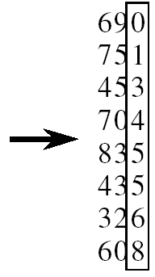
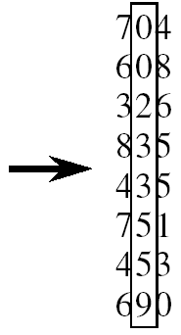
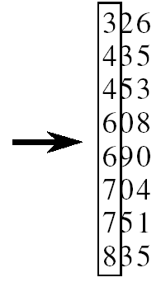
RADIX-SORT
Alg.: RADIX-SORT(A, d)
for i ← 1 to d
do use a stable sort to sort array A on digit i
1 is the lowest order digit, d is the highest-order digit

Slide 25
Analysis of Radix Sort
Given n numbers of d digits each, where each digit may take up to k possible values, RADIX-SORT correctly sorts the numbers in Θ(d(n+k))
  One pass of sorting per digit takes Θ(n+k) assuming that we use counting sort
  There are d passes (for each digit)

Slide 26
Correctness of Radix sort
We use induction on number of passes through each digit
Basis: If d = 1, there’s only one digit, trivial
Inductive step: assume digits 1, 2, . . . , d-1 are sorted
  Now sort on the d-th digit
  If a_{d} < b_{d}, sort will put a before b: correct
  a < b regardless of the low-order digits
  If a_{d} > b_{d}, sort will put a after b: correct
  a > b regardless of the low-order digits
  If a_{d} = b_{d}, sort will leave a and b in the
  same order (stable!) and a and b are
  already sorted on the low-order d-1 digits

Slide 27
Bucket Sort
Assumption:
  the input is generated by a random process that distributes elements uniformly over [0, 1)
Idea:
  Divide [0, 1) into n equal-sized buckets
  Distribute the n input values into the buckets
  Sort each bucket (e.g., using quicksort)
  Go through the buckets in order, listing elements in each one
Input: A[1 . . n], where 0 ≤ A[i] < 1 for all i
Output: elements A[i] sorted
Auxiliary array: B[0 . . n - 1] of linked lists, each list initially empty

Slide 28
Example - Bucket Sort
A
1
.78
.17
.39
.26
.72
.94
.21
.12
.23
.68
B
0
/
2
1
.17
.12 /
3
2
.26
.21
.23 /
4
3
.39 /
5
4
/
6
5
/
7
6
.68 /
8
7
.78
.72 /
9
8
/
10
9
.94 /

Slide 29
Example - Bucket Sort
.12
.17
.21
.23
.26
.39
.68
.72
.78
.94 /
0
/
1
.12
.17 /
2
.21
.23
.26 /
3
.39 /
4
/
5
/
6
.68 /
7
.72
.78 /
Concatenate the lists from
0 to n – 1 together, in order
8
/
9
.94 /

Slide 30
Correctness of Bucket Sort
Consider two elements A[i], A[ j]
Assume without loss of generality that A[i] ≤ A[j]
Then ⎣nA[i]⎦ ≤ ⎣nA[j]⎦
  A[i] belongs to the same bucket as A[j] or to a bucket with a lower index than that of A[j]
If A[i], A[j] belong to the same bucket:
  sorting puts them in the proper order
If A[i], A[j] are put in different buckets:
  concatenation of the lists puts them in the proper order

Slide 31
Analysis of Bucket Sort
Alg.: BUCKET-SORT(A, n)
for i ← 1 to n
do insert A[i] into list B[⎣nA[i]⎦]
for i ← 0 to n - 1
do sort list B[i] with quicksort sort
concatenate lists B[0], B[1], . . . , B[n -1] together in order
return the concatenated lists
O(n)
Θ(n)
O(n)
Θ(n)

Slide 32
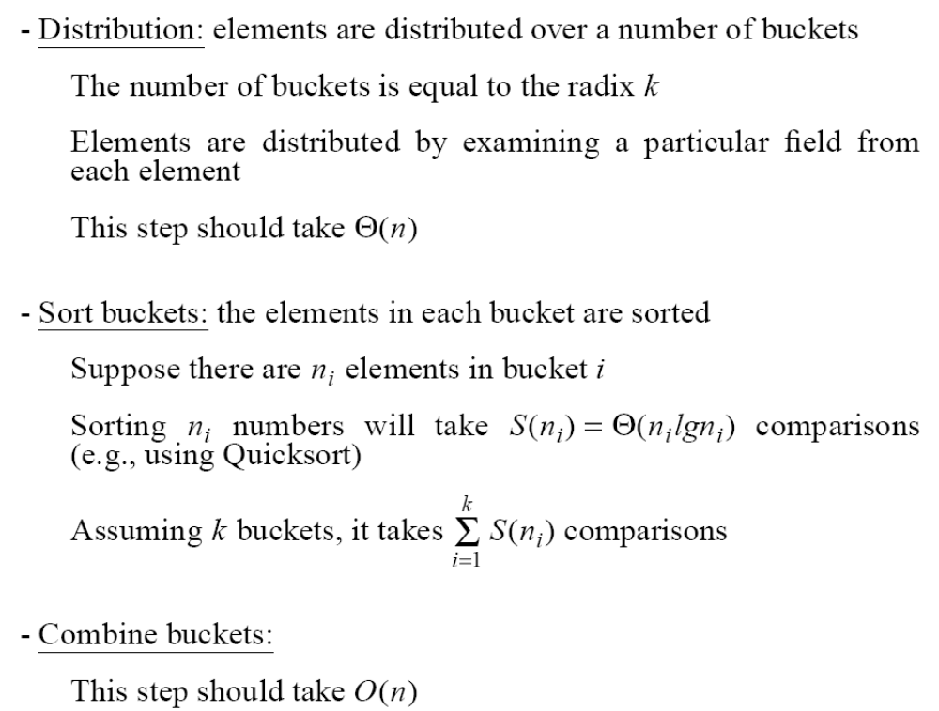
Radix Sort Is a Bucket Sort

Slide 33
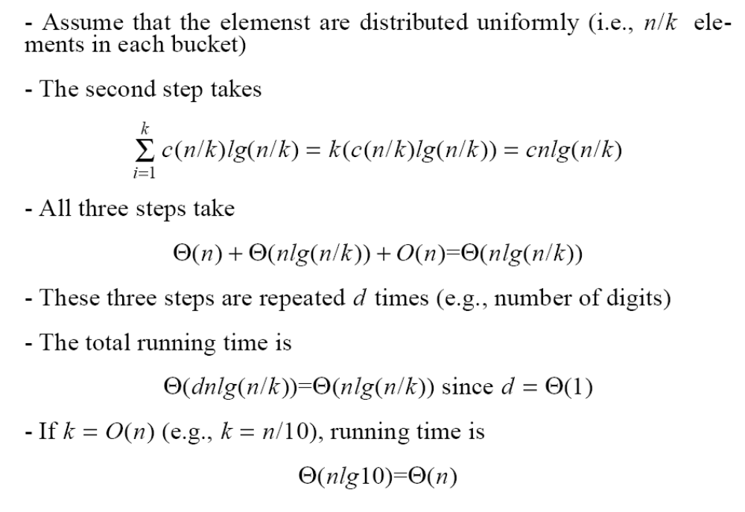
Running Time of 2nd Step

Slide 34
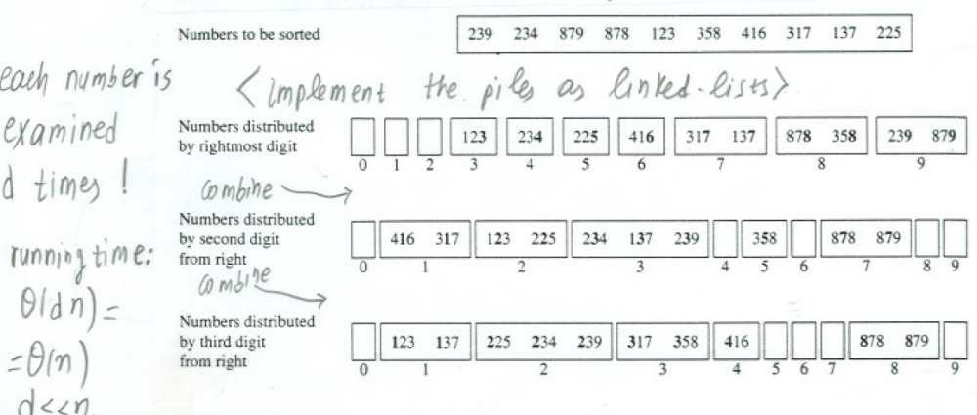
Radix Sort as a Bucket Sort

Slide 35
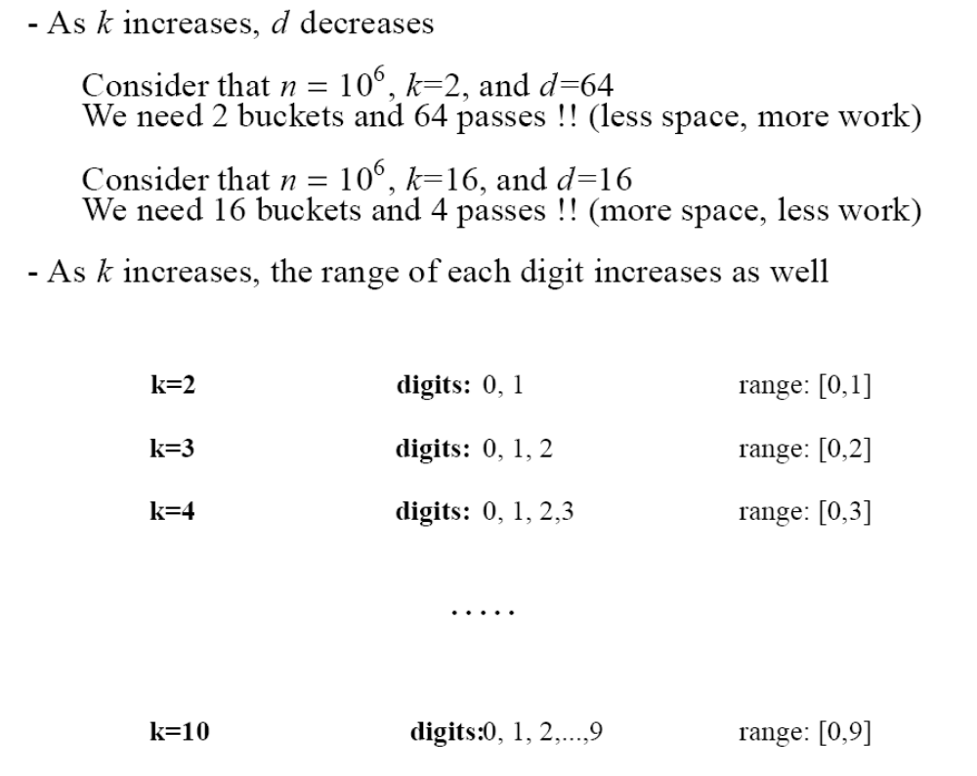
Effect of radix k
4

Slide 36
Problems
You are given 5 distinct numbers to sort. Describe an algorithm which sorts them using at most 6 comparisons, or argue that no such algorithm exists.

Slide 37
Problems
Show how you can sort n integers in the range 1 to n² in O(n) time.

Slide 38
Conclusion
Any comparison sort will take at least nlgn to sort an array of n numbers
We can achieve a better running time for sorting if we can make certain assumptions on the input data:
  Counting sort: each of the n input elements is an integer in the range [0 ... r] and r=O(n)
  Radix sort: the elements in the input are integers represented with d digits in base-k, where d=Θ(1) and k =O(n)
  Bucket sort: the numbers in the input are uniformly distributed over the interval [0, 1)

